Slide 1

TensorFlow Model Optimization Toolkit
by Lee Wai Yeong

Slide 2
Content Page
Technical Prerequisites
Introduction
Tensorflow Model Optimization Toolkit
Weight pruning
Weight clustering
Quantization
Collaborative Optimization

Slide 3


Technical Prerequisites

Slide 4
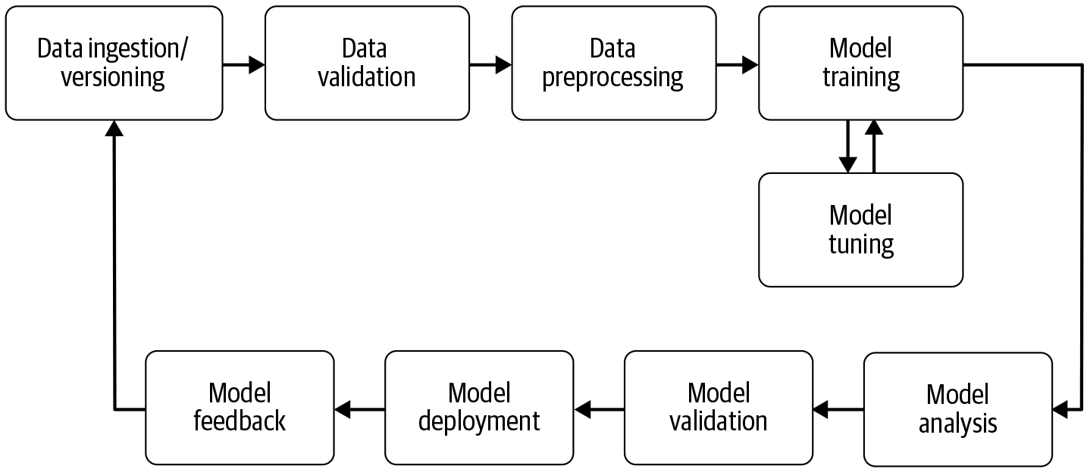
Machine/deep learning pipeline
Tfmot

Slide 5
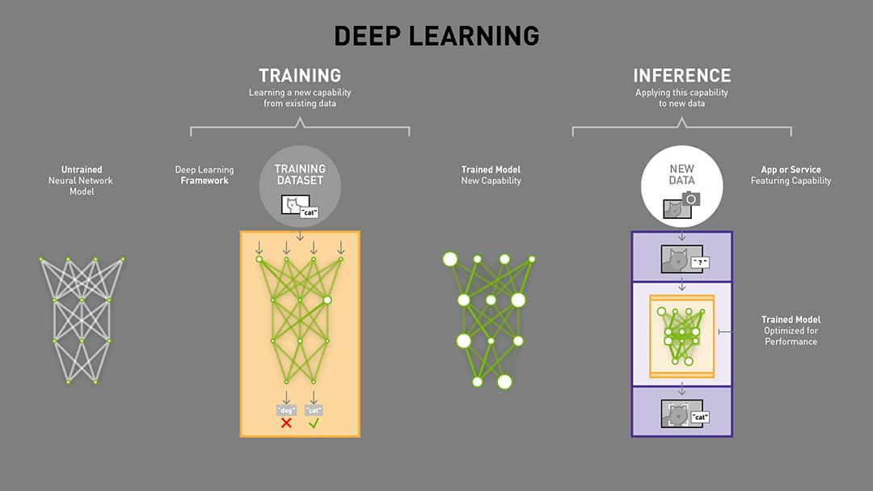
Notes:
Forward prop and backward prop

Slide 6
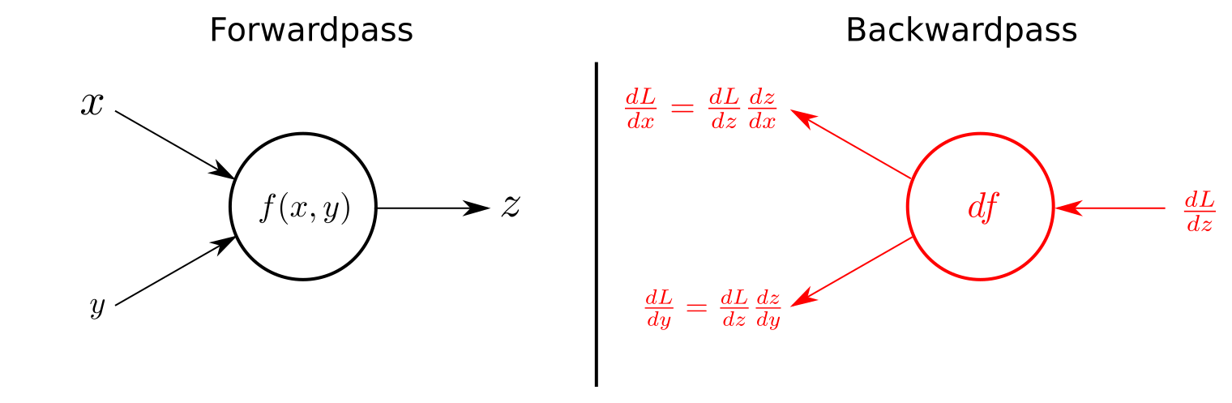
Backpropagation

Slide 7
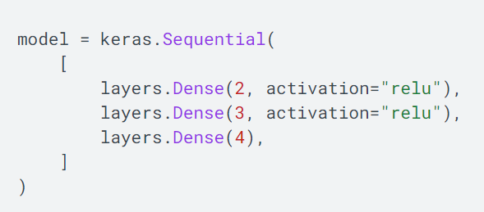
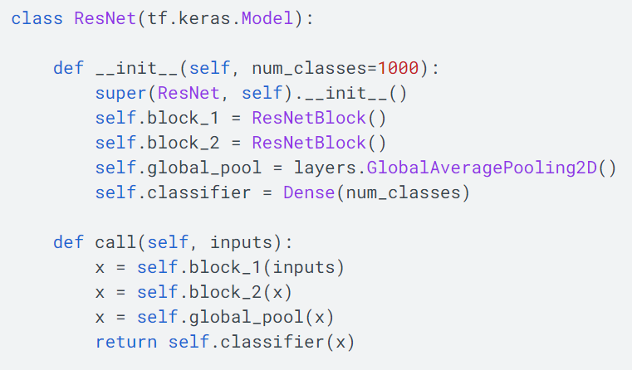
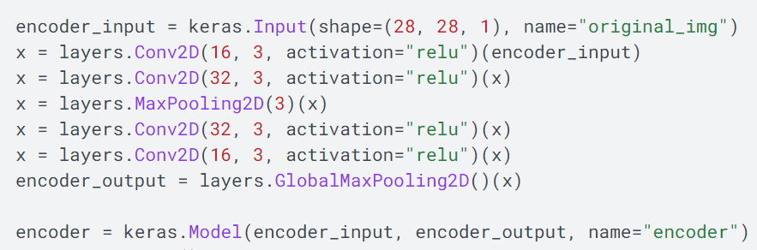
Tensorflow Model API
Sequential
Functional
Subclassing

Slide 8

Introduction

Slide 9
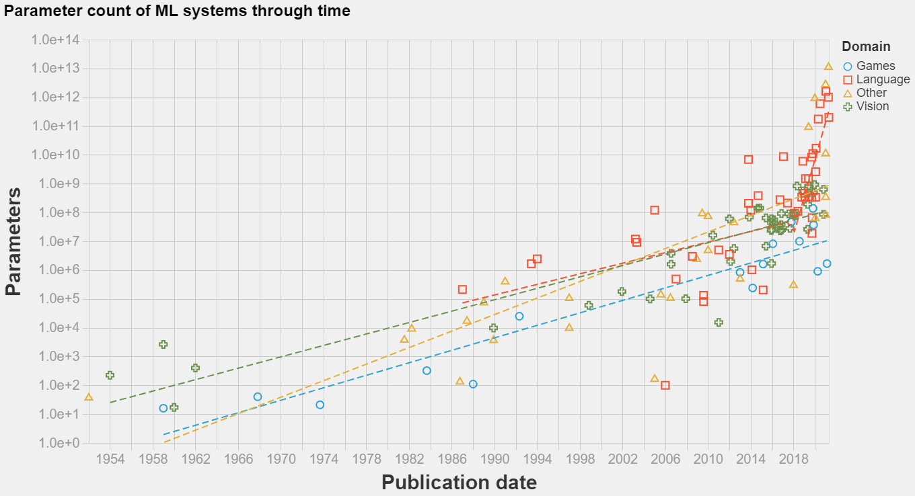
Technology advancements in ML/AI
Source: https://towardsdatascience.com/parameter-counts-in-machine-learning-a312dc4753d0

Slide 10
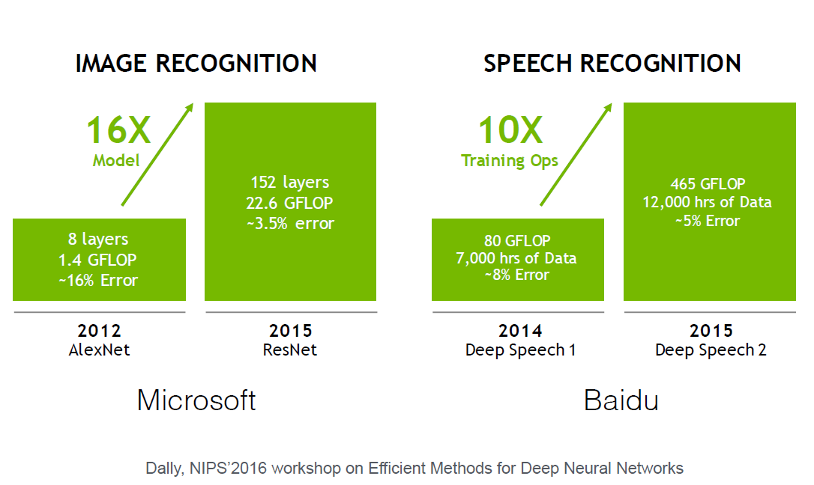
Model size increases exponentially

Slide 11
Factors of performance and efficiency
Model size
Model parameters, model complexity, model depth
Speed
Training time, inference time
Energy efficiency
Memory allocation, energy consumption, price

Slide 12

TensorFlow Model Optimization Toolkit

Slide 13
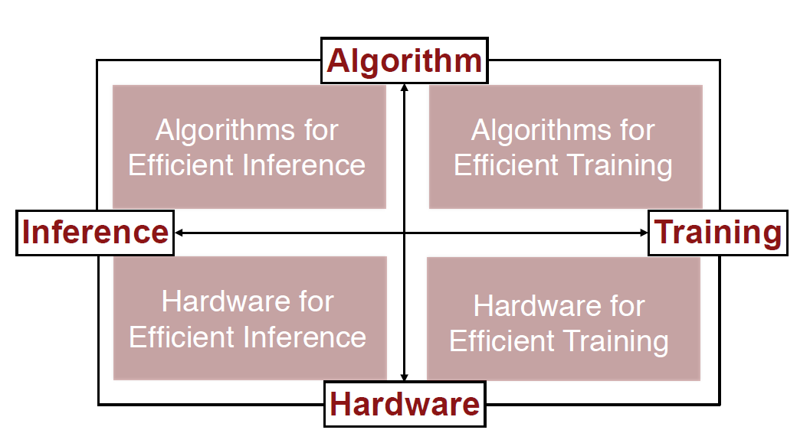
Optimization Methods
Parallelization, model architecture
Tensorflow Model Optimization Toolkit
CPU, GPU, TPU
Source: Standford University CS231n_2017 Lecture Slides

Slide 14


TensorFlow Model Optimization Toolkit (tfmot): Pros and Cons
Pros
Minimal accuracy trade-off
Cons
Only supports Sequential & Functional models
Minimal support for Subclassed models
Deploying models on edge devices with restrictions on processing, memory and/or power-consumption.
Reducing payload size for over-the-air model updates.
Reducing latency and cost for inference for both cloud and edge devices (e.g. mobile, IoT).

Slide 15
TensorFlow Model Optimization Toolkit (tfmot)
Weight pruning
Weight sharing/weight clustering/trained quantization
Quantization
Post-training quantization
Quantization aware training (QAT)
Collaborative optimization
All of the above!!!
Model needs to be trained prior to optimization

Slide 16

Weight Pruning

Slide 17
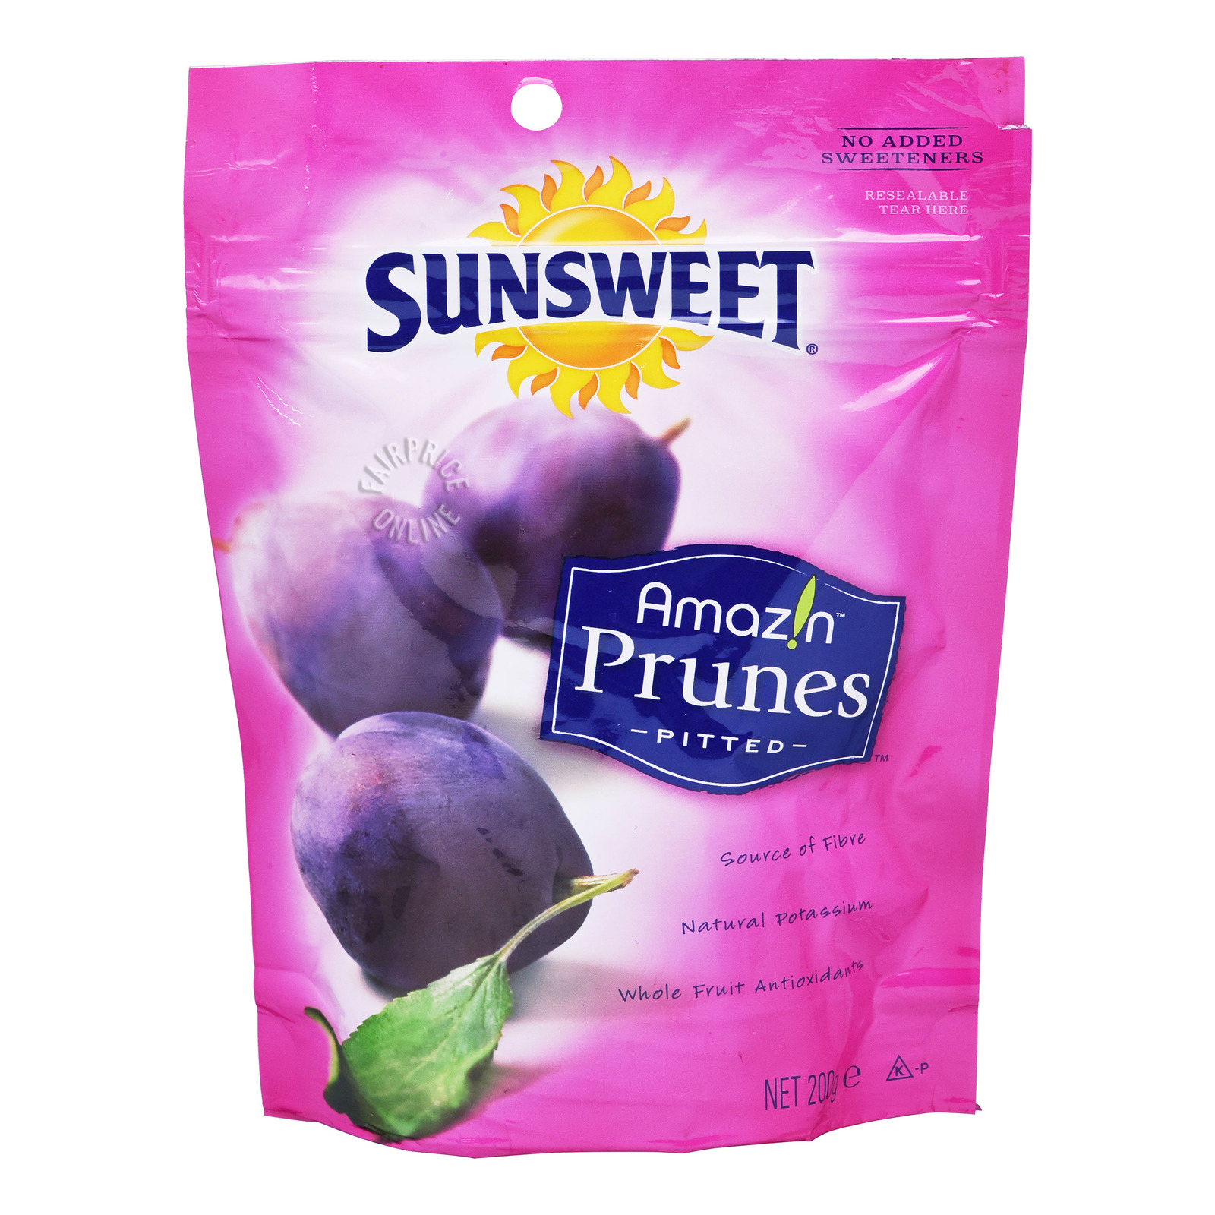
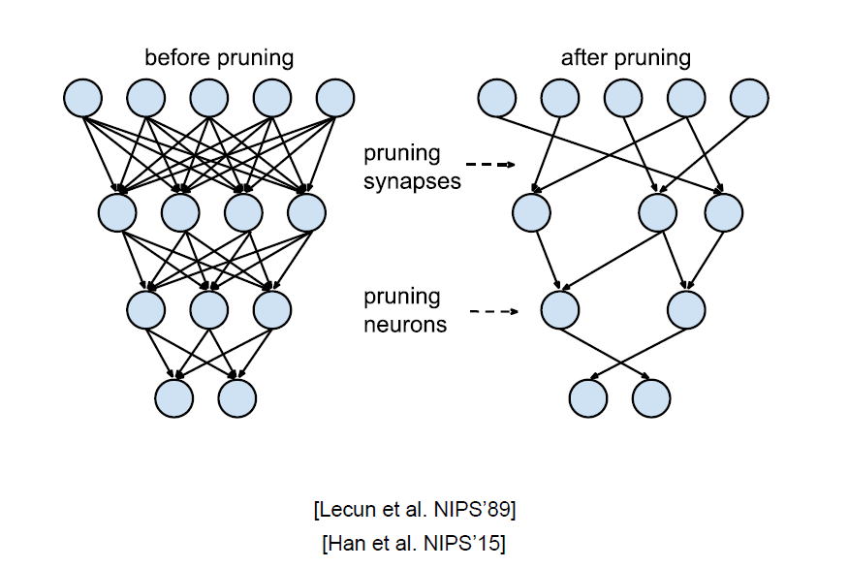
Weight pruning
Magnitude-based pruning
Gradually zeros out model weights during training ➔ Sparse models
Sparse models easier to compress ➔ Lesser inference time

Slide 18
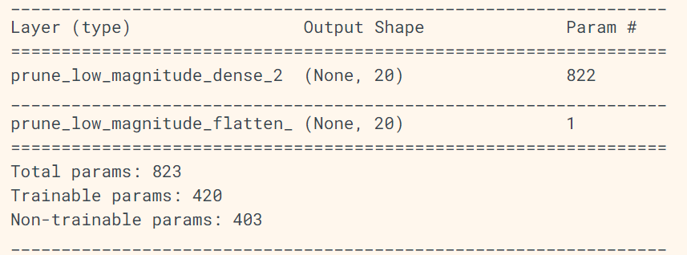
Weight pruning
Pruning methods
Whole model
Some layers
Custom layers
Prune certain parts of layer
Source: Tensorflow Official Documentation

Slide 19

Hands-on: Weight pruning

Slide 20
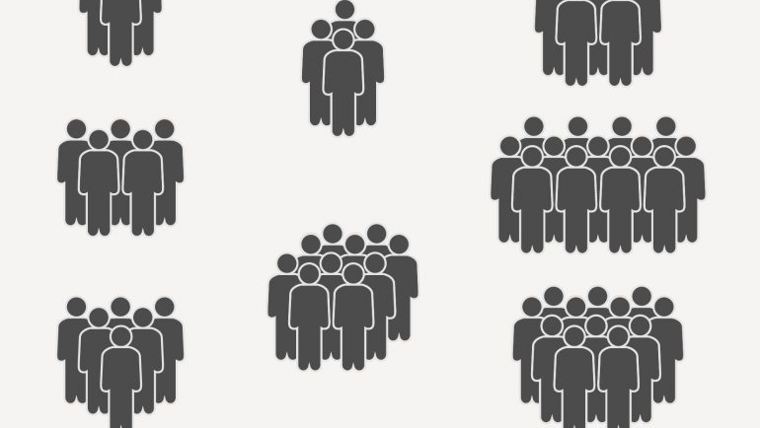
Weight clustering

Slide 21
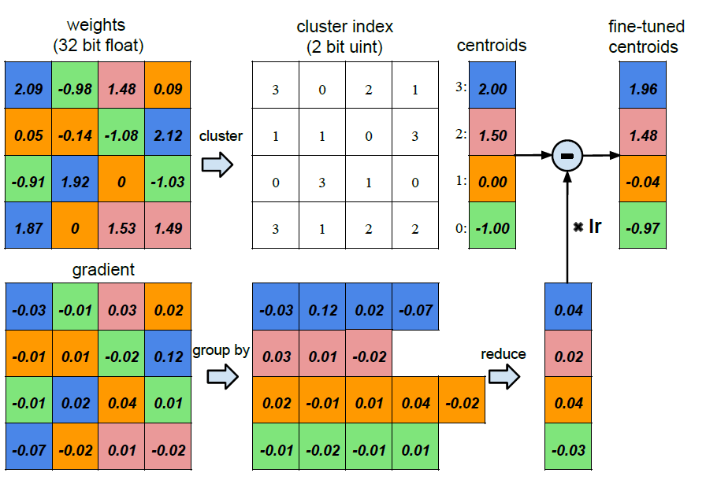
Weight sharing/ Weight clustering/ Trained quantization
Weights are shared with each other using a common number
#unique weights decreases
Weights distribution becomes more discretized
Weights precision does not change
Source: Standford University CS231n_2017 Lecture Slides

Slide 22
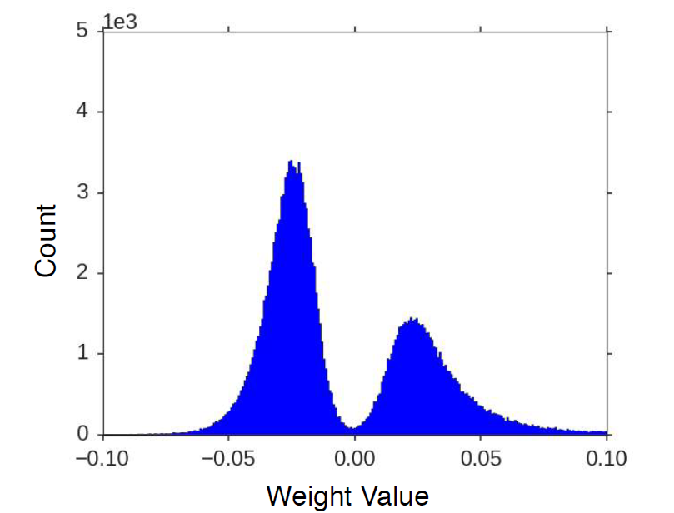
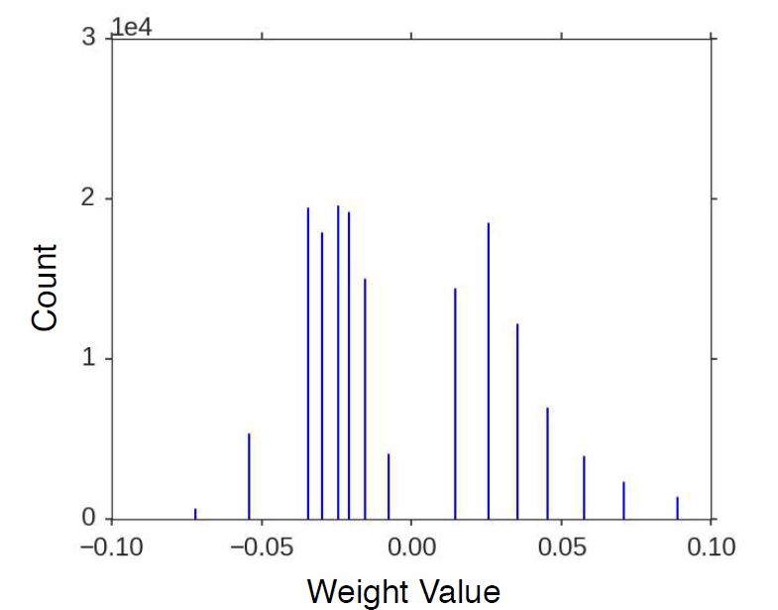
Weight clustering: Weight distribution
Clustering

Slide 23
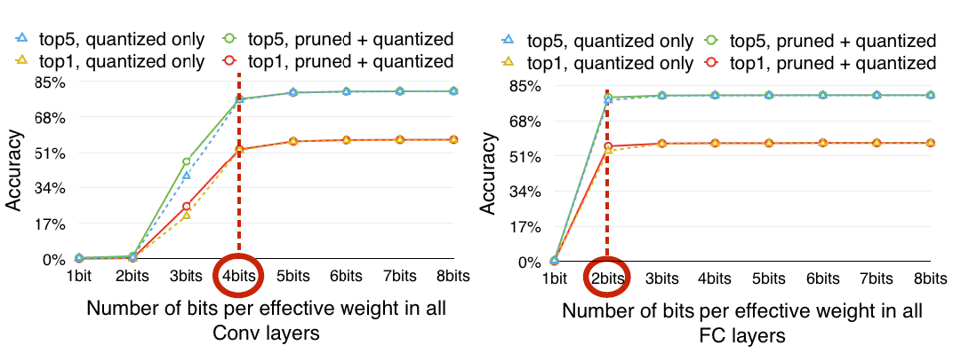
Weight clustering: #bits
Source: Standford University CS231n_2017 Lecture Slides

Slide 24
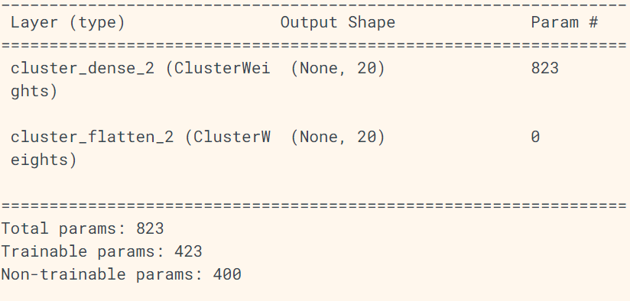
Weight clustering
Clustering methods
Whole model
Some layers
Convolutional layers per channel
Custom layers
Cluster certain parts of layer
Source: Tensorflow Official Documentation

Slide 25
Hands-on: Weight clustering

Slide 26
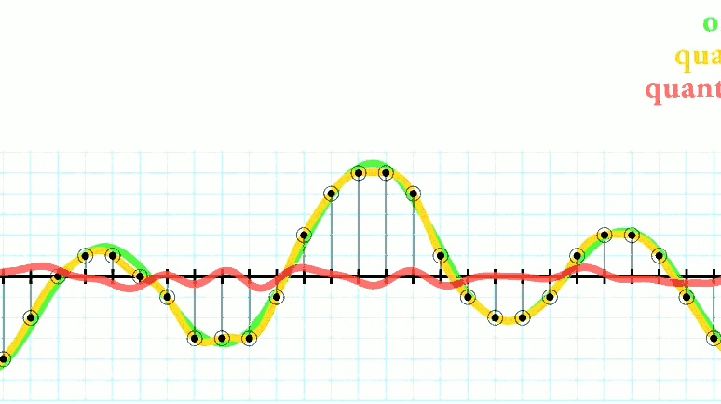
Quantization

Slide 27
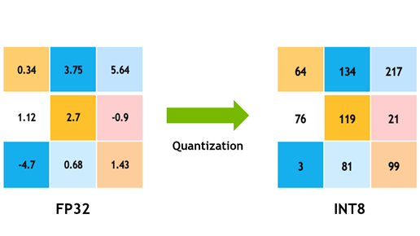
Quantization
Use lower precision
e.g.8-bit instead of 32-bit
Similar to weight clustering
Source: https://developer.nvidia.com/blog/achieving-fp32-accuracy-for-int8-inference-using-quantization-aware-training-with-tensorrt/
Quantization-aware training (QAT)
More difficult
Higher accuracy
Post-training quantization
Easier to use
Lower accuracy than QAT

Slide 28
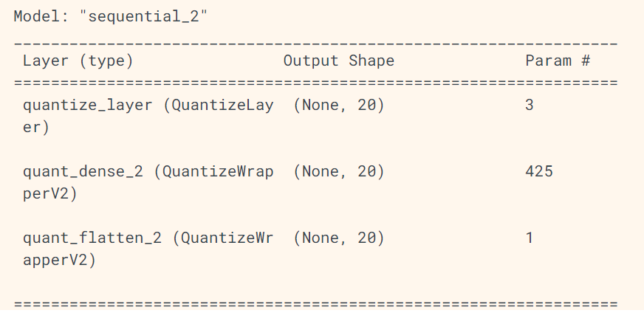
Quantization-aware training (QAT)
Use lower precision for weights during training (backwardprop)
QAT methods
Whole model
Some layers
Custom layers
Quantize certain parts of layer
Source: Tensorflow Official Documentation

Slide 29
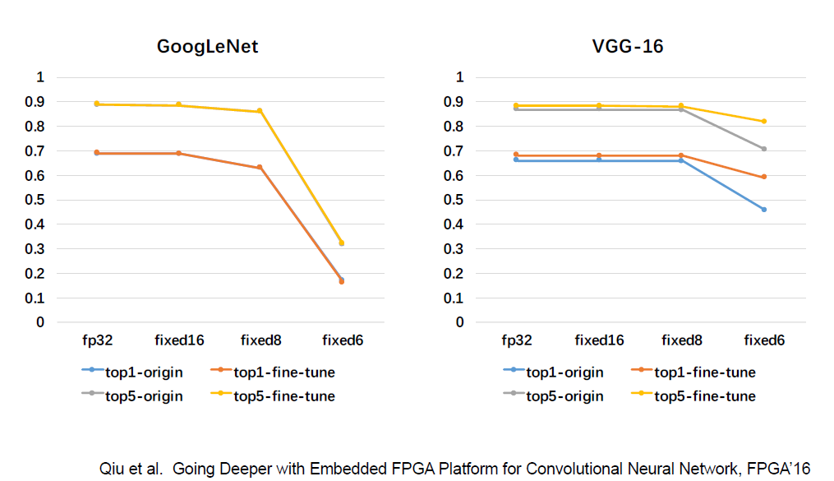
QAT: #bits

Slide 30
Post-training Quantization
Perform quantization on weights after training is completed
Uses TFLiteConverter

Slide 31
Hands-on: Quantization

Slide 32

Collaborative optimization

Slide 33
Collaborative optimization
Combination of pruning, clustering and/or quantization
However, applying a different technique destroys the previous results
Sparsity preserving clustering
Sparsity preserving quantization aware training (PQAT)
Cluster preserving quantization aware training (CQAT)
Sparsity and cluster preserving quantization aware training

Slide 34
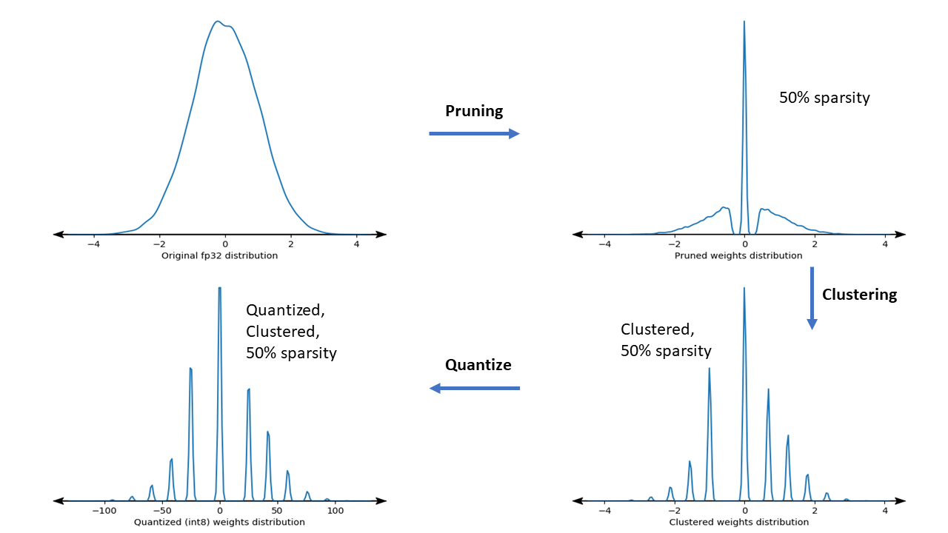
Collaborative optimization
Source: Tensorflow Official Documentation

Slide 35
Summary of Collaborative Optimization
Type of Collaborative Optimization | Description
Sparsity preserving clustering | Pruning + Clustering
CQAT | Clustering + Quantization
PQAT | Pruning + Quantization
CPQAT | Pruning + Clustering + Quantization/ Sparsity preserving clustering + Quantization

Slide 36
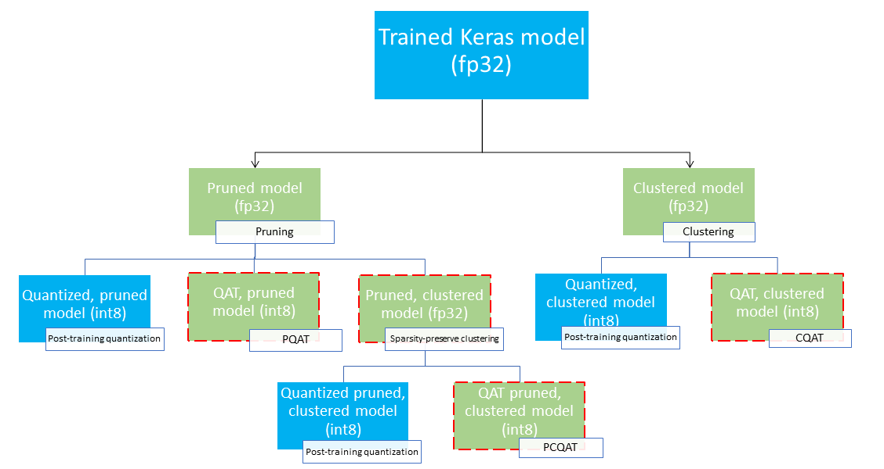
Deployment path tree
Source: Tensorflow Official Documentation

Slide 37
Hands-on: Collaborative optimization

Slide 38
Summary of Optimization Methods
Optimization Method | Description
Weight pruning | Reduce #weights
Weight clustering | Reduce #weights
Quantization | Reduce #bits per weight
Collaborative Optimization | Reduce #weights and #bits per weights

Slide 39
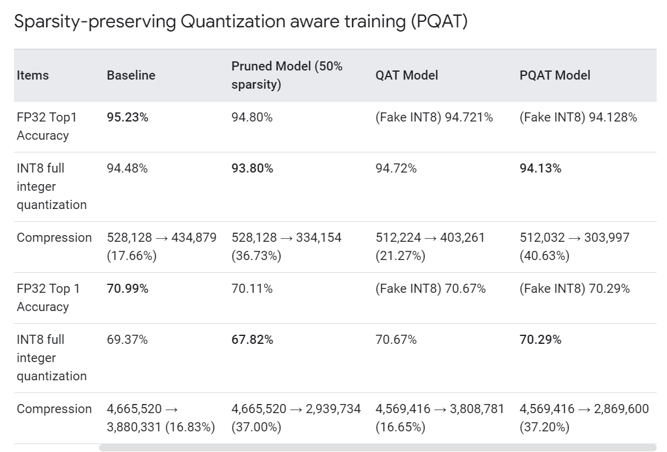
Accuracy Results
Source: Tensorflow Official Documentation

Slide 40

THANK YOU

